Slide 1

Prediction of Breast Cancer
Koh Si Ting

Slide 2
Agenda
1
2
3
Introduction
Dataset
Cyto-Model
4
5
6
Web Application
Histo-Model
Conclusion
Breast Cancer
Tools
Cytopathology Results
Histopathology Images
Methodology
Feature Importance
Model Comparison & Evaluation
Methodology
Visualization
Model Evaluation
Using Flask
Simple Demo
Insights
Notes:
This is my agenda. I will start off with Introduction, Dataset, my 2 predictive models which I called it Cyto-model and Histo-model, a simple web application demo and I will end off with my conclusion

Slide 3
1
Introduction

Slide 4

Top Cause of Cancer Death (Female Singaporeans)
Notes:
I think all of you already know, breast cancer basically occurs when harmful or malignant cancer cells are found in the breast tissues.
In Singapore, Breast cancer is actually the leading cause of cancer death in women today.

Slide 5
Diagnosis of Breast Cancer
Patient History
Physical Examination
Diagnosic Tests
Clinical Diagnosis
Mammogram
Ultrasound
Magnetic Resonance Imaging (MRI)
Biopsy
Based on results:
Cytopathology (Study of Cells)
Histopathology (Study of Tissue)
Notes:
Diagnosis of cancer begins with a thorough patient history and physical examination.
Biopsy which is taking a sample of tissue from the body is the only definitive way to make a diagnosis of breast cancer, aside from other diagnostic tests. This is because cytopathology (study of cells) and histopathology (study of tissue) are the main tools utilized in the diagnosis of cancer.

Slide 6
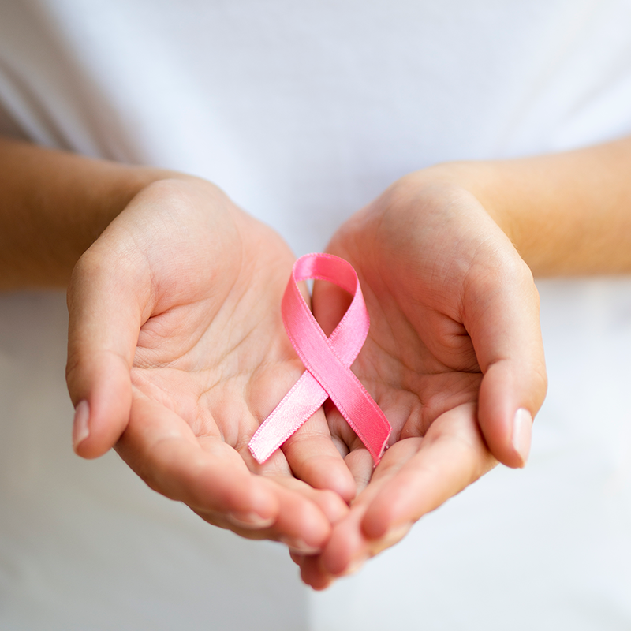
Motivation
Create comprehensive diagnostic AI tools to assist pathologists with an automatic detection of tumor/malignant cells
Notes:
For my motivation for this project, as prediction so far is done manually by pathologists, it varies from expert to expert. Therefore my goal is to create comprehensive diagnostic AI tools to assist pathologists with an automatic detection of tumors (malignant cells), thus able to make more accurate and consistent diagnostic result.

Slide 7
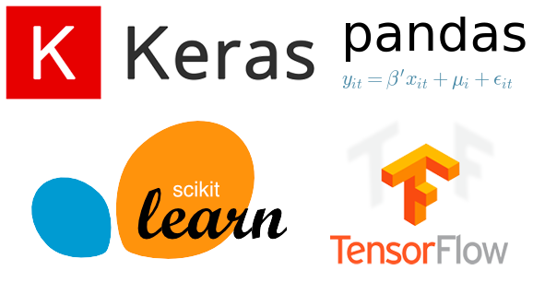
Tools
Pandas, Numpy: DataFrame, Transforming data
Matplotlib & Seaborn : Plot graphs
Supervised ML Algorithms : Binary Classification
Tensorflow & Keras: Deep Learning for Image Classification
Sckit-learn: Evaluation metrics
Flask: Web Application
Notes:
This are the tools I used for my project, mostly on the supervised machine learning algorithms and Tensorflow Keras for my predictive models

Slide 8
2
Datasets
Notes:
Onto my dataset

Slide 9
Dataset 1 (Kaggle)
Cytopathology Results
No. of Records | 569
No. of Features | 10 Unique Features (Computed in Mean, Standard Error - SE, Largest Mean) => Resulting in 30 features in total
Types of Features | Characteristics of the cell nuclei present in digitalized image from biopsy E.g. Radius, Texture, Concavity
Target | Benign / Malignant
Notes:
I actually explored 2 different datasets, one is on the cytopathology result in which it consists of characteristics of the cell nuclei present in digitalized image from biopsy

Slide 10
Dataset 2 (Kaggle)
Histopathology Images
No. of Patients | 279
No. of Records | 277, 524 Images
Type of Images | Patches of tissue slide from Biopsy (appearance of the tissue as seen through a microscope)
Target | Cancer / Non-Cancer
Notes:
Second dataset is on histopathology raw images which are patches of tissue from biopsy result
As you can see the dataset is pretty imbalanced, I will talk about dealing with it in my later slides.

Slide 11
3
Cyto-Model
Using Supervised Machine Learning (ML) Algorithms
Notes:
I will first introduce my predictive model on cytopathology result

Slide 12
Methodology (Cyto-model)
Data Cleaning + EDA + Feature Selection
Train, Validate and Test Models & Model Selection
Evaluation of Chosen Model
Drop highly correlated (>0.8) features
Use Recursive feature elimination with cross validation (RFECV) + RandomForest for feature selection
Use GridSearch CV (CV=5) to tune hyper-parameters
Comparison: Accuracy, ROC-AUC score, Log-loss and F1-score
Confusion matrix
Model Performance
ROC curve
Precision & Recall Graph
Notes:
For the methodology of my model, I started off with data cleaning, EDA and feature selection. Then I train, validate and test my model using gridsearchCV to tune my hyperparameters. After which, I compared and evaluated my chosen model.

Slide 13
Feature Importance
Notes:
These are the best features for best accuracy as per Recursive feature elimination with cross validation (RFECV) and RandomForest. As you can see, I managed to reduce from 30 to 7 features for modelling.

Slide 14
Model Comparison
Model | Accuracy | AUC Score | Log-Loss | F1-Score
SVM | 89% | 0.89 | 0.32 | 0.84
Logistic Regression | 97% | 0.99 | 0.12 | 0.96
Naïve Bayes | 96% | 0.99 | 0.13 | 0.93
Decision Tree | 96% | 0.97 | 0.93 | 0.93
Random Forest | 97% | 0.99 | 0.11 | 0.97
KNN | 90% | 0.95 | 0.49 | 0.85
XGBoost | 97% | 0.99 | 0.09 | 0.96
Notes:
This is a comparison of all the different algorithms I tried for my cyto-model. XGBoost seems to perform best in terms of accuracy and log loss therefore I choose it evaluate further.

Slide 15
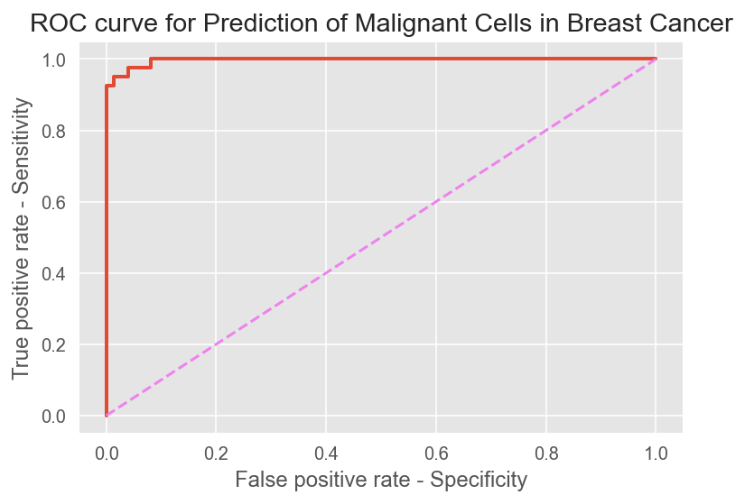
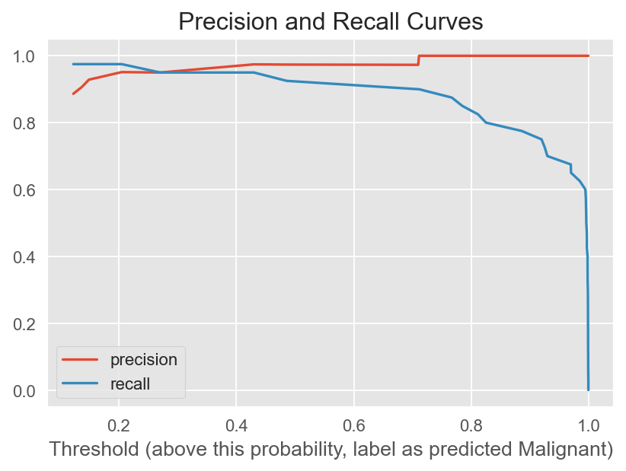
Model Chosen: XGBoost
ROC-AUC Score = 0.997
Threshold = 0.1 - 0.3
Notes:
To optimize my model further, I plotted the Precision and Recall curve help me decide the threshold value to adjust.

Slide 16
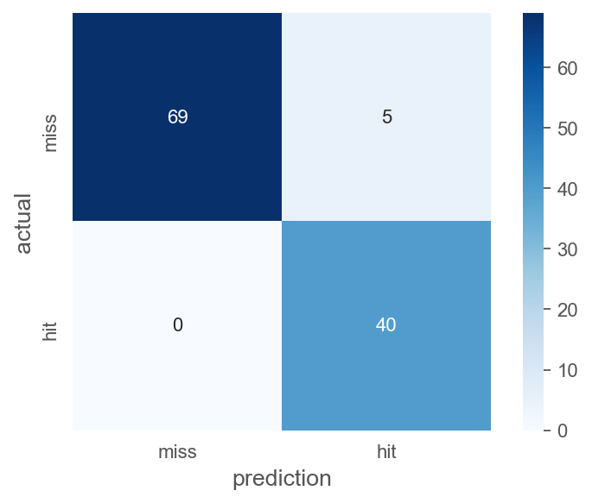
Model Evaluation (XGBoost)
True Negatives (TN)
False Positives (FP)
Performance Results
Threshold | 0.10
Accuracy | 97%
Precision | 89%
Recall (Sensitivity) | 100%
Specificity | 93%
False Negatives (FN)
True Positives (TP)
Notes:
Now, for my confusion matrix, as I do not want any False negative (FN) which means missing out any person wrongly labeled as healthy but actually has cancer, this undesirable outcome can lead to delaying the treatment which I don’t want. Therefore, I adjusted my threshold to optimize my recall to 100 % without compromising too much on my precision. Finally, my model has accuracy of 97% in predicting malignant cells.

Slide 17
4
Histo-Model
Using Tensorflow and Keras
Notes:
Now to my second predictive model using the histopathology Images.

Slide 18
Methodology (Histo-model)
Data Pre-processing
Model Evaluation
Build a model (Sequential) with Dense layers
Flatten input image dimensions to 1D
Normalize image pixel values
CNN Model with Keras
Deal with imbalanced class sizes (Undersampling)
Use Dropout layer and Earlystopping to prevent overfitting
Train model and make predictions
Metrics: Accuracy, AUC, Precision, Recall, F1-score
Confusion matrix
Encode labels (target)
Notes:
I first started off with data pre-processing in which I flatten the input image dimensions to 1D and normalize the image pixel values. I did undersampling strategy to deal with the imbalanced class sizes. Next I build my CNN model and evaluated on its performance.

Slide 19
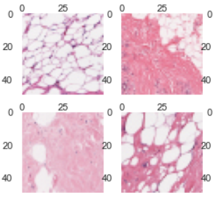
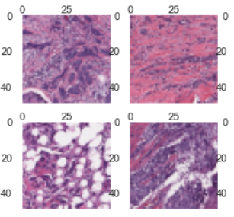
Visualization (Histology Images)
Healthy Patches
Cancer Patches
Patches with cancer look more violet and crowded than healthy ones.
Notes:
These are some visualization of the images. As you can see, the patches with cancer look more violet and crowded than the healthy ones.
*higher res patches?

Slide 20
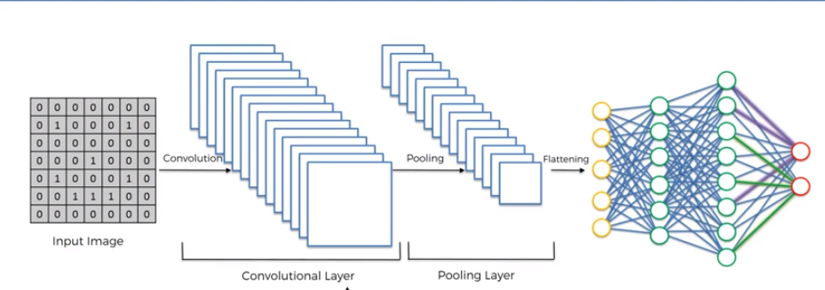
CNN Model
3. Flatten: matrix convert into linear array to input into the nodes of neural network
Convolution Neural network (CNN) , a class of deep, feed-forward artificial neural networks (visual imagery)
1. Convolution: extract features from the input image (matrix of pixel values)
2. Pooling: reduces the dimensionality but retains the most important information
Notes:
Before I move on to training my model, I will briefly go through how CNN works. Building CNN consist of 3 parts: Convolution, pooling and flattening
Convolution
The primary purpose of Convolution is to extract features from the input image. Convolution preserves the spatial relationship between pixels by learning image features using small squares of input data.
Pooling
Pooling (also called subsampling or downsampling) reduces the dimensionality of each feature map but retains the most important information.
Flattening
Matrix is converted into a linear array so that to input it into the nodes of our neural network.

Slide 21
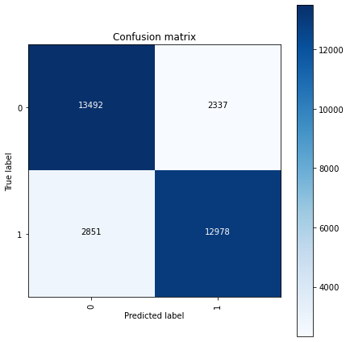
Model Evaluation (CNN)
Performance Results
Loss | 0.38
Accuracy | 83%
AUC-score | 0.91
Precision | 84%
Recall (Sensitivity) | 82%
F1-score | 0.83
Notes:
Finally, this is the model performance, it has an accuracy of 83% and AUC of 91%. Not that bad I would say.

Slide 22
5
Web Application
Using Flask
Notes:
For my predictive models, I actually created a very simple flask app and this is a demo of how it works.

Slide 23
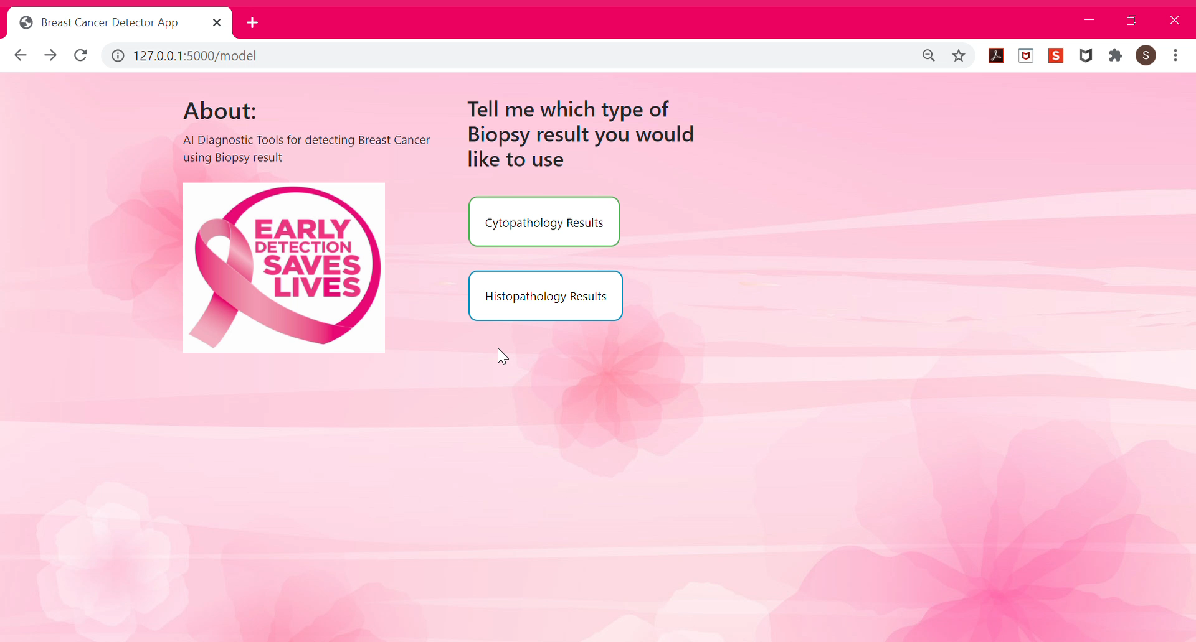

Slide 24
6
Conclusion
Notes:
Now my conclusion and insights on my models

Slide 25
Insights
Flexibility
AI Tools
2 Predictive Models
Consistent and Accurate results
CNN Result
PyTorch
Web App
Transfer Learning
Notes:
First, as I utilized and created 2 different predictive models, it allows the pathologist the flexibility to choose which to use depending the result they have, reducing the limitations and restriction of using my predictive model for diagnosis.
Second, as is relies on AI and does not vary from different pathologists, thus it is able to produce consistent and accurate results which are more reliable and trustworthy. Things to improve is my CNN Result and ofcoz my very simple web app. Lastly, for future work, I would like to explore pytorch or transfer learning

Slide 26
—Mahatma Gandhi
“A correct diagnosis is three-fourths the remedy.”
Notes:
Before I end off, I will like to share this quote from Gandhi, a correct diagnosis is ¾ the remedy. With AI diagnostic tools like mine, I believe we are one step ahead in making accurate and consistent diagnosis and in turn yielding (yeeld) improvement in clinical outcomes.

Slide 27


Thanks!
DO YOU HAVE ANY QUESTIONS?
Please keep this slide for attribution.
@ sitingkoh1808

